Slide 1



Analyzing Agricultural Productivity Across Indian States
NAME:-S.BALA BHAVYASRI
AICTE STU_STU672cbf9c9899f1730985884

Slide 2

Learning Objectives
Understand regional agricultural productivity,analyze how agricultural output varies across Indian states and identify key influencing factors.
Master data collection and preprocessing,learn to source, clean, and transform raw agricultural data for analysis using Excel and Power BI.
Create insightful dashboards with Power BI,Build interactive visualizations to present crop-wise and state-wise agricultural performance.
Apply DAX for advanced analytics,Use calculated columns and measures to compute yields, trends, and productivity indices.
Draw data-driven conclusions and recommendations,Generate actionable insights to support agricultural decision-making and future improvements.
GOAL

Slide 3
Dataset Summary:
The dataset used in this project comprises 19,689 records, capturing detailed agricultural data across multiple Indian states over several years. Each record represents a unique data point for a particular crop grown in a specific state during a specific season and year. This rich dataset is highly valuable for both exploratory data analysis and advanced visualization, especially when used with a tool like Power BI.
The data spans multiple crop years, beginning from 1997 onward, which allows for a longitudinal analysis of agricultural trends, including shifts in crop production, changing seasonal patterns, and regional disparities in productivity.
Geographical and Temporal Coverage:
Geographical Scope: Covers a wide range of Indian states and union territories, enabling a pan-India comparative analysis.
Temporal Range: Includes year-wise data across decades, supporting trend analysis and historical comparisons.
Seasonal Detail: Includes data categorized by season—Kharif, Rabi, and Whole Year—which provides insights into seasonal crop cycles and regional dependencies on monsoons or irrigation.
This level of granularity is particularly useful for policymakers, agronomists, and researchers aiming to evaluate how climatic, input-based, and regional factors influence agricultural productivity.

Slide 4
Data Overview – Metrics and Analytical Potential
Key Columns and Their Significance:
Crop Indicates the name of the crop cultivated (e.g., Rice, Cotton, Wheat). Helps categorize data for crop-wise analysis.
Crop_Year Specifies the year of cultivation, enabling time-series analysis.
Season Distinguishes between cropping periods like Kharif (monsoon), Rabi (winter), and Whole Year crops.
State Identifies the Indian state where the crop was grown. Essential for region-based comparisons.
Area (hectares) Denotes the land area under cultivation. Used to calculate yield and understand land utilization.

Slide 5
Input & Output Variables for Analysis:
Production (tonnes) Total output produced for a given crop-state-year combination.
Annual_Rainfall (mm) Measures the rainfall received annually in that region, crucial for evaluating rain-dependent agriculture.
Fertilizer (kg or tonnes) Quantifies the amount of fertilizer used. Can be used to study input efficiency.
Pesticide (kg or tonnes) Represents pesticide usage, allowing correlation with crop health and yield.
Yield (tonnes/hectare) A calculated metric showing productivity. It is derived by dividing production by area and is central to this project’s analysis.

Slide 6
Problem Statement
Agricultural productivity in India varies significantly across states due to diverse climatic conditions, resource availability, and farming practices. Despite being a critical sector for the nation’s food security and economy, many regions face challenges such as inefficient use of fertilizers and pesticides, unpredictable rainfall patterns, and limited access to modern farming technologies. There is a pressing need for a comprehensive data-driven analysis to identify the underlying factors affecting productivity disparities and to enable targeted interventions.
However, the complexity and volume of agricultural data make it difficult for policymakers and stakeholders to extract actionable insights using traditional methods. Therefore, this project aims to leverage Power BI’s advanced data visualization and analytical capabilities to analyze multi-year agricultural datasets, uncover productivity trends, and provide clear, interactive insights that can guide effective agricultural planning and decision-making across Indian states.

Slide 7
Solution
To address the challenges in understanding and improving agricultural productivity across Indian states, this project utilizes Power BI, a robust data visualization and business intelligence tool. By integrating multi-year datasets on crop production, area cultivated, rainfall, fertilizer, and pesticide usage, the project creates an interactive dashboard that offers a comprehensive view of agricultural trends and patterns.
The solution involves:
Data preprocessing and cleaning to ensure accuracy and consistency.
Use of DAX formulas to calculate key metrics such as yield (production per hectare) and input efficiency.
Deployment of visual analytics like maps, bar charts, line graphs, and scatter plots to reveal spatial and temporal productivity variations.
Implementation of slicers and filters for customized, user-driven exploration by year, crop, season, and state.
Correlation analysis between inputs (rainfall, fertilizer, pesticide) and outputs (yield), helping identify inefficiencies and areas for improvement.
This approach empowers policymakers, researchers, and agricultural stakeholders with actionable insights, enabling data-driven decisions to optimize resource use, improve crop yields, and enhance sustainable farming practices across diverse Indian regions.

Slide 8
Tools and Technology Used
Power BI Power BI is the primary tool used for data visualization and analysis in this project. It enables importing large agricultural datasets, building interactive dashboards, and creating dynamic reports. Power BI’s drag-and-drop interface and powerful DAX (Data Analysis Expressions) formulas allow calculation of key metrics such as crop yield, growth trends, and input-output relationships. Features like slicers and filters provide user-friendly exploration of data by state, crop, year, and season.
Microsoft Excel Excel was used for initial data cleaning, preprocessing, and exploratory analysis. It helped identify missing values, remove duplicates, and perform basic statistical checks before importing the data into Power BI. Excel’s functions and pivot tables also assisted in preliminary aggregation and validation of dataset metrics.
Python (Optional) For more advanced data manipulation, Python libraries such as Pandas and Matplotlib can be used to preprocess data, handle missing entries, and generate additional insights. Python scripts can also be integrated with Power BI for automated data transformation.
Data Sources The agricultural data was sourced from official government repositories such as the Ministry of Agriculture & Farmers Welfare and open data portals, ensuring reliability and authenticity. The dataset includes parameters like crop production, area, rainfall, fertilizer, and pesticide usage across Indian states over multiple years.
Computing Environment The analysis and visualization were performed on a standard computing environment with Windows OS, leveraging Power BI Desktop’s capabilities. For collaborative sharing, Power BI Service (cloud platform) can be used to publish dashboards accessible across devices.

Slide 9
Methodology
1. Data Collection
The first step involves collecting comprehensive agricultural datasets from reliable sources such as the Ministry of Agriculture, Government of India, and open data portals. The dataset includes multi-year data on crop production, cultivated area, rainfall, fertilizer, and pesticide usage across different Indian states and seasons.
2. Data Cleaning and Preprocessing
Raw data often contains inconsistencies, missing values, or errors. Using Microsoft Excel and Power BI’s query editor, the data is cleaned by:
Removing duplicate or irrelevant records
Handling missing or null values through imputation or removal
Standardizing formats for dates, states, and crop names
Creating calculated columns such as yield (production per hectare)
3. Data Modeling
Data is structured to establish relationships between various fields. In Power BI, relationships between tables (if any) are defined, and key performance indicators (KPIs) are calculated using DAX expressions. For example, yield is computed as production divided by area, and correlation metrics may be added to analyze the effect of rainfall or fertilizer on yield.

Slide 10
4.Data Visualization and Dashboard Development
Interactive dashboards are built using Power BI’s visualization tools:
Maps to show state-wise productivity variations
Bar charts and pie charts to compare crop-wise and state-wise production
Line charts to analyze temporal trends over multiple years
Scatter plots to identify correlations between inputs (fertilizer, rainfall) and outputs (yield) Slicers and filters are added to allow users to customize views by year, crop, state, and season.
5. Insight Generation and Analysis
The visualizations help identify key trends such as:
High-performing and low-performing states
Impact of rainfall variability on crop yields
Efficiency of fertilizer and pesticide use
Seasonal productivity differences (Kharif vs Rabi) These insights form the basis for recommendations to improve agricultural productivity and resource allocation.
6. Reporting and Presentation
The final step involves compiling the findings into reports and presentations, using Power BI’s export features or integrating visuals into PowerPoint slides to communicate results clearly to stakeholders such as policymakers, farmers, and researchers.

Slide 11
Introduction to Agricultural Productivity in India
Agriculture remains the backbone of India’s economy, providing livelihood to more than half of the population. Understanding agricultural productivity across Indian states is crucial for improving food security, economic growth, and rural development. Productivity measures how efficiently inputs like land, labor, fertilizers, and water are converted into crop output. Various factors influence agricultural productivity including climate conditions, irrigation facilities, use of modern technology, and state-level policies.
Trends in Agricultural Productivity
Over the last few decades, India has seen significant changes in agricultural productivity, driven by the Green Revolution, technological advancements, and increased use of fertilizers and pesticides. Productivity varies widely across states due to differences in soil quality, rainfall patterns, cropping seasons, and access to resources. Northern states like Punjab and Haryana typically show high yields due to better irrigation and farming techniques, while some eastern and central states lag behind due to dependence on rainfall and traditional methods.
Seasonal trends also impact productivity, with Kharif (monsoon) and Rabi (winter) crops showing distinct growth patterns. Understanding these trends requires analysis of large datasets encompassing multiple years, states, and crops.

Slide 12
Role of Power BI and Data Visualization slicers to explore data dynamically. For instance, choropleth maps highlight state-wise productivity variations, bar charts compare crop yields, and line graphs reveal time-based trends
Power BI is a powerful business analytics tool that helps in transforming raw agricultural data into meaningful visual stories. By importing datasets with crop production, rainfall, fertilizer use, and other parameters, Power BI enables the creation of interactive dashboards with maps, charts, and .
Flowcharts and data models in Power BI can outline the relationship between variables like rainfall, fertilizer input, and crop yield, helping users understand cause-effect and correlation. Visual tools enhance decision-making by making complex data accessible and actionable for policymakers, researchers, and farmers.
Using Flowcharts to Model Productivity Analysis
Flowcharts can be used to represent the data analysis process systematically:
Data Collection: Gather state-wise crop production, area, rainfall, and input data.
Data Cleaning: Preprocess the data to handle missing values and inconsistencies.
Data Modeling: Define relationships between variables and calculate key metrics like yield.
Visualization: Create charts and maps to display productivity patterns.
Insight Generation: Analyze trends, identify problem areas, and propose recommendations.
Decision Making: Use insights to inform agricultural policies and resource allocation.
This structured approach ensures clarity and thorough understanding of agricultural productivity factors.

Slide 13
GitHub repository links of the working project
WEEK 1 TASK:- https://github.com/Bhavyasri1312/Analyzing-Agriculture-production-week-1-Task/blob/main/Analyzing%20Agriculture%20week%201%20task.pbix
WEEK 2 TASK:- https://github.com/Bhavyasri1312/Analyzing-Agricultural-Productivity-Across-Indian-States-Week-2-task/blob/main/Analyzing%20Agricultural%20Productivity%20Across%20Indian%20States%20week%202%20task.pbix

Slide 14
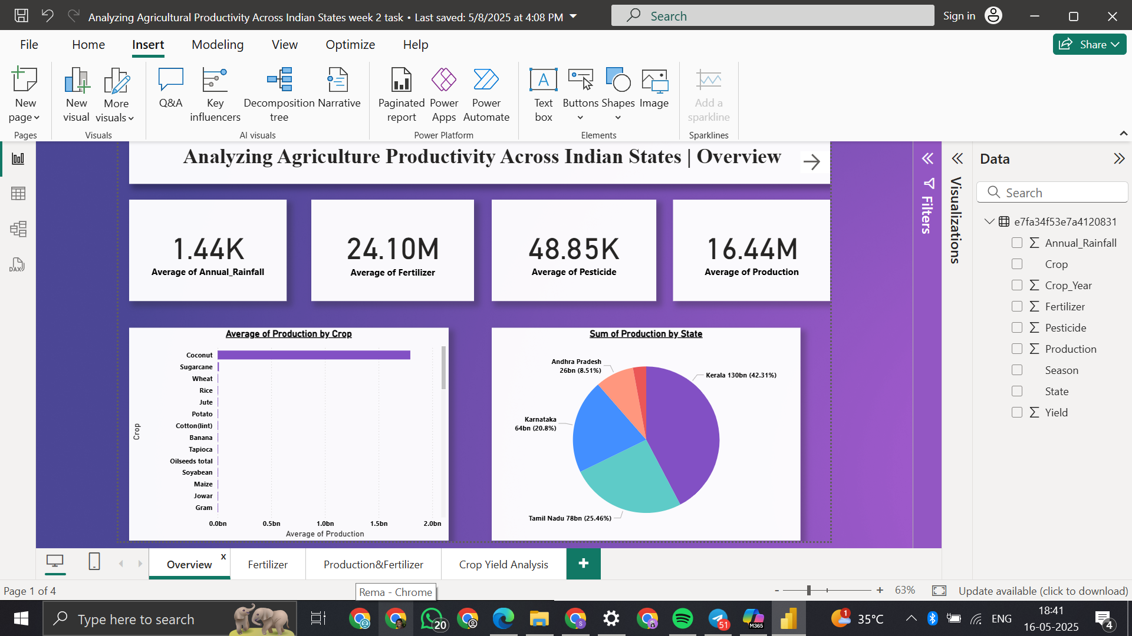
Key Metrics:
Average Annual Rainfall: 1.44K mm
Average Fertilizer Usage: 24.10M tons
Average Pesticide Usage: 48.85K tons
Average Production: 16.44M tons
Top Crop by Production (Bar Chart):
Coconut dominates crop production significantly compared to other crops like Sugarcane, Wheat, and Rice.
Top Producing States (Pie Chart):
Kerala (42.31%) leads in total agricultural production.
Followed by Tamil Nadu (25.46%), Karnataka (20.8%), and Andhra Pradesh (8.51%).
Screenshots of the working project

Slide 15
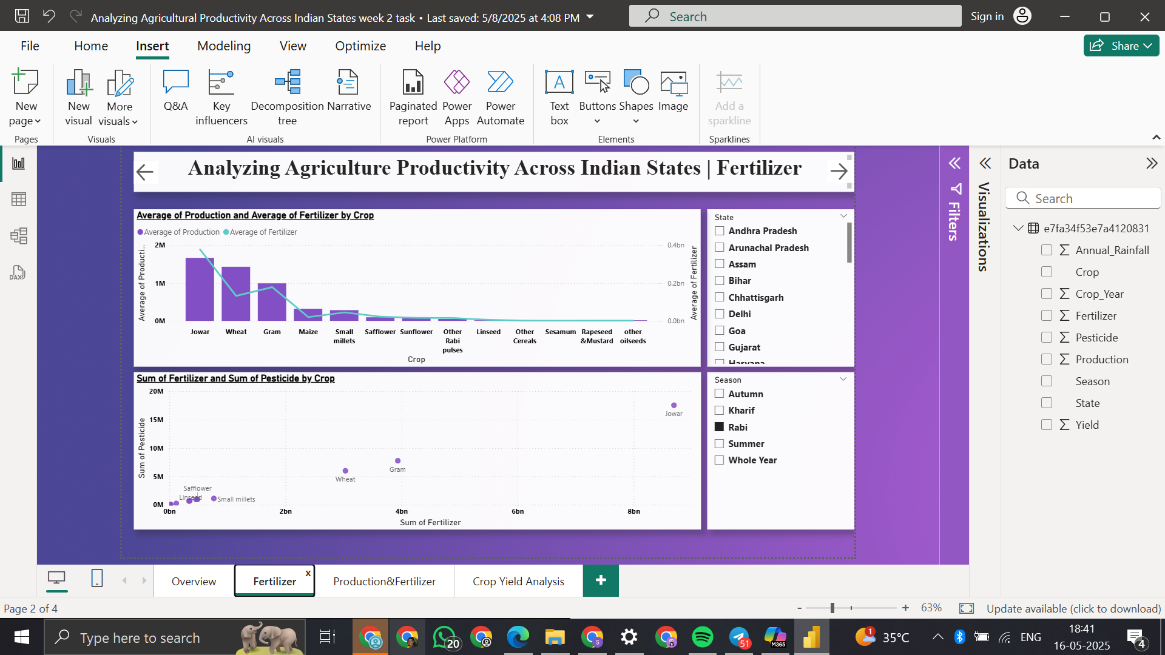
Crop-wise Analysis:
Jowar, Wheat, and Gram show high average production.
These crops also correspond with higher fertilizer usage.
Fertilizer vs Pesticide Scatter Plot:
Jowar shows both the highest fertilizer and pesticide use.
Crops like Small millets and Safflower have low input use.
Filters Available:
State and Season filters allow detailed segmentation of analysis.

Slide 16
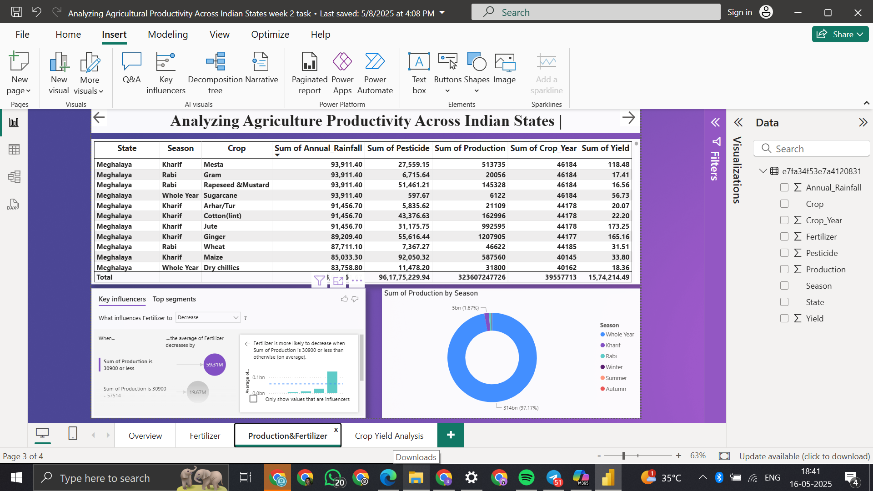
Tabular View (State-wise, Crop, and Season):
Detailed breakdown includes:
Sum of Rainfall, Pesticide, Production, Crop Year, and Yield.
Example: In Meghalaya, crops like Mesta and Gram show varied input and yield levels.
Key Influencers Analysis:
Fertilizer usage decreases significantly when production is ≤ 30900 tons.
Production by Season (Donut Chart): Majority of production (97.17%) occurs in “Whole Year” season category.

Slide 17
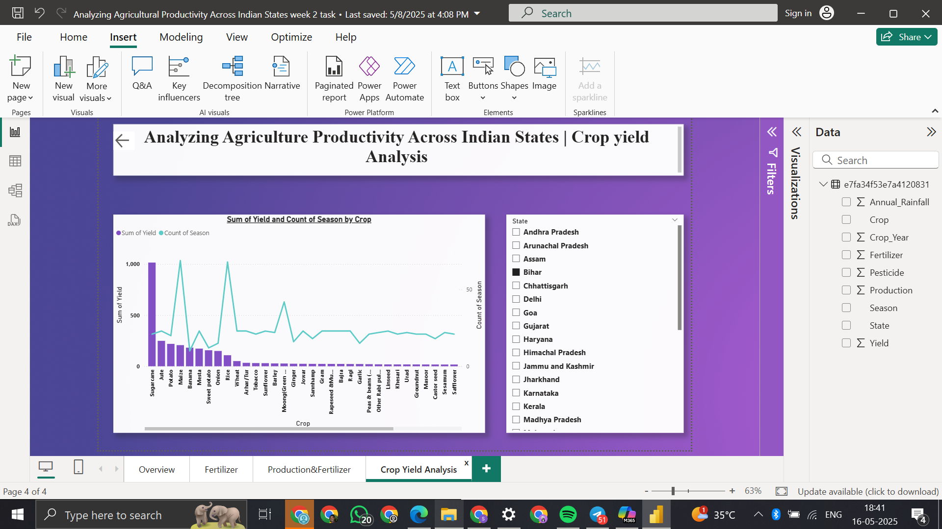
Chart: Sum of Yield and Count of Season by Crop:
Sugarcane has the highest total yield.
Some crops like Banana and Potato have high seasonal frequency.
State Filter:
Enables per-state exploration of crop yield performance.
Currently filtered for Bihar.

Slide 18
Conclusion
This project successfully demonstrates how data analytics and visualization tools like Power BI can be effectively utilized to understand and improve agricultural productivity across Indian states. By analyzing key variables such as crop production, cultivated area, rainfall, fertilizer, and pesticide usage, the project provides a holistic view of the factors influencing yield disparities across regions and seasons.
The interactive dashboards developed in Power BI allow users to explore trends dynamically—revealing that states with better access to irrigation, modern farming techniques, and input efficiency tend to have higher yields. Seasonal patterns and resource usage also play a significant role, as seen in the correlation between rainfall levels and crop output.
This data-driven approach makes it easier for policymakers, agricultural experts, and stakeholders to identify underperforming regions, understand the reasons behind productivity gaps, and develop targeted strategies to improve agricultural outcomes. By turning complex datasets into insightful visual narratives, the project not only enhances transparency and decision-making but also supports the long-term goal of sustainable and equitable agricultural development in India.

